Slide 1
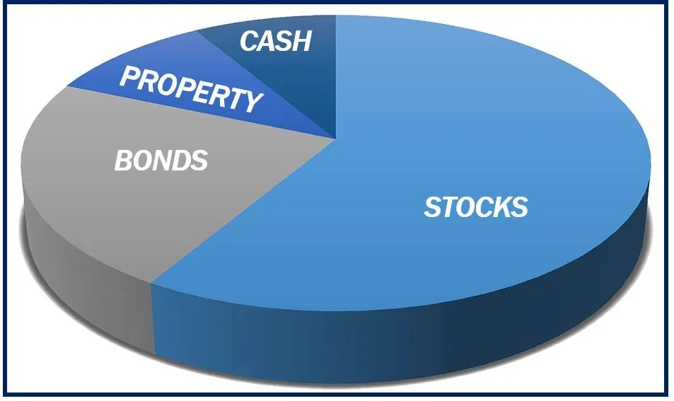
Lecture 5: Modern Portfolio Theory I
HE Tai-Sen
FINANCIAL ECONOMICS

Slide 2
Modern Portfolio Theory l
Introduction
Lectures 2 - 4
Lectures 5 - 6
Investment assets can be categorized into broad asset classes, such as bonds, stocks, real estate, commodities, and so on. Investors make two types of decisions in constructing their portfolios:
The asset allocation decision is the choice among these broad asset classes.
The security selection decision is the choice of which particular securities to hold within each asset class.

Slide 3
Modern Portfolio Theory l
Outline
Risk and Risk Aversion (6.1)
Scenario Analysis
The Asset-allocation Decision (6.2)
The Risk-free Asset (6.3)
Portfolios of One Risky Asset and a Risk-free Asset (6.4)
Risk Tolerance and Asset Allocation (6.5)

Slide 4
Modern Portfolio Theory l
Risk and Risk Aversion
When investors are choosing their optimal portfolio, we assume that they only care about return (measured by expected return) and risk (measured by variance), their utility function can be:
[Risk Preference Survey] Which option do you prefer?
Option A: Guaranteed $4.
Option B: 50% chance of getting $10 and a 50% chance of getting nothing.
“A” measures individual’s risk-aversion. Typically, we assume that investors are risk-averse.
Notes:
Large; Small

Slide 5
Modern Portfolio Theory l
Risk and Risk Aversion
The indifference curve
Expected Return
Mean-variance (M-V) criterion
Portfolio A dominates B if E(r_{A})≥E(r_{B}) and σ_{A}≤σ_{B}
And at least one inequality is strict.
Standard Deviation
Notes:
Large; Small

Slide 6
Modern Portfolio Theory l
Scenario Analysis
Individuals would perform scenario analysis to determine the return and risk for all of the assets available on the market.
Assume initial price is $100.
State of the Market | Probability | Year-end Price | Cash Dividends | Holding-period Return | Deviations from the Mean | Squared Deviations from Mean
EXCELLENT | 25% | 126.50 | 4.5 | 31% | 21.24% | 0.0451
GOOD | 45% | 110.00 | 4.0 | 14% | 4.24% | 0.0018
POOR | 25% | 89.75 | 3.5 | -6.75% | -16.51% | 0.0273
CRASH | 5% | 46.00 | 2.0 | -52% | -61.76% | 0.3815

Slide 7
Modern Portfolio Theory l
Scenario Analysis
Please calculate:
Holding-period Return
Expected Return E(r) = ______
Variance Variance = _____
Standard Deviation Std = ______
9.76%
0.038
19.49%
Notes:
Expected return=25%*31%+45%*14%+25%*(-6.75%)+5%*(-52%)=9.76%
Variance=25%*0.0451+45%*0.0018+25%*0.0273+5%*0.3815=0.038
Std=(Variance)^(1/2)=19.49%

Slide 8
Modern Portfolio Theory l
The Asset-allocation Decision
An individual maximizes his/her utility subject to the budget constraint. The optimization problem:
Max
s.t. Budget Constraint
6.3: One risk-free asset
6.4: One risky asset and a risk-free asset
7.2: Two risky assets
7.3 Two risky assets and a risk-free asset
7.4 Many risky assets and a risk-free asset

Slide 9
Modern Portfolio Theory l
One Risk-free Asset
It is common practice to view T-bills as the risk-free asset.
Very low default risk
Insensitive to interest rate fluctuations
Expected Return
Standard Deviation

Slide 10

Modern Portfolio Theory l
Portfolios of One Risky Asset and a Risk-free Asset
Suppose there are only two assets. One is risky and the other is risk-free. You are deciding how much money to invest in the risky asset and in the risk-free asset.
 | Expected Return | Standard Deviation
Risky | 15% | 22%
Risk-free | 7%
Notes:
0%

Slide 11
Modern Portfolio Theory l
Portfolios of One Risky Asset and a Risk-free Asset
Let’s first solve it graphically:
Expected Return
Optimal complete portfolio (The optimal portfolio choice for an individual)
Capital allocation line (Risk-return combinations available to investors)
Standard Deviation

Slide 12
Modern Portfolio Theory l
Portfolios of One Risky Asset and a Risk-free Asset
The budget line tells you the relationship between portfolio’s expected return and standard deviation.
Let y be the proportion of the investment budget allocated to the risky asset.
1-y be the proportion of the investment budget allocated to the risk-free asset.
The complete portfolio (C) is composed of y in the risky asset and 1-y in the risk-free asset.
y : proportion in the risky asset;
r_{c} : RR of the complete portfolio; r_{p} : RR of the risky asset; r_{f} : RR of the risk-free asset
E(r_{c} ): ER of the complete portfolio; E(r_{p}): ER of the risky asset; E(r_{f}): ER of the risk-free asset
σ_{c} : Std of the complete portfolio; σ_{p} : Std of the risky asset; σ_{f} : Std of the risk-free asset

Slide 13
Modern Portfolio Theory l
Portfolios of One Risky Asset and a Risk-free Asset
r_{c}= y*r_{p}+(1-y)*r_{f}
E(r_{c}) = y*E(r_{p})+(1-y)*r_{f} = r_{f} +y*[E(r_{p})-r_{f}] =7%+y*8% ……(1)
V(r_{c})=y² *V(r_{p})+ (1-y)²*V(r_{f})+2*y*(1-y)*Cov(r_{p} , r_{f}) = y² * V(r_{p})
=> σ_{c} = y*σ_{p} = y*(22%)……(2)
Combining 1 and 2, we can derive the risk-return relationship.
σ_{c}= y*(22%) => y= σ_{c} / (22%)
E(r_{c}) = 7%+(σ_{c} / (22%)) * 8% = 7%+0.36 σ_{c} …... Capital Allocation Line
Slope of CAL
Review:
M is a linear combination of two random variables N₁ and N₂.
So, M=w N₁ +(1-w) N₂
E(M)= w E(N₁)+(1-w) E(N₂)
V(M)= w² V(N₁) +(1-w)² V(N₂)+2w(1-w) COV(N₁, N₂)
Notes:
If you want to higher expected returns, you have to bear higher s.d.

Slide 14
Modern Portfolio Theory l
Portfolios of One Risky Asset and a Risk-free Asset
Capital allocation line (CAL): a line that depicts all risk-return combinations available to investors, formed between a risky and a risk-free asset.
Expected Return
Slope of CAL: Reward-to-volatility ratio
Sharpe ratio
Borrowing at the risk-free rate
Standard Deviation

Slide 15
Modern Portfolio Theory l
Risk Tolerance and Asset Allocation
Now, let’s solve for the optimal portfolio:
The optimal portfolio
Assume A=4,
Comparative static analysis: the larger the value of A, the more you would invest in the _______ asset.
risk-free

